Slide 1
ITk ASICs Register Converters
Greta Goldberg, Albrun Johnson
ITk Strips System Tests and DAQ Meeting

Slide 2
Table of Contents
Overview
Register Interface
ABCStar v1 Example
HCCStar v1 Example

Slide 3
Overview
Converts between output signal (register content) and readout information for each register
Can input binary, hexadecimal, or decimal signal
Update: can now select registers by name, and hexadecimal number in addition to decimal number
Update to new register maps for ABCStar v1, HCCStar v1, and AMACStar
Old version: http://www.hep.upenn.edu/ATLAS_upgrade/ITk/ASICs/Registers.html
New version: https://github.com/gretagoldberg/Register_Converter.git

Slide 4
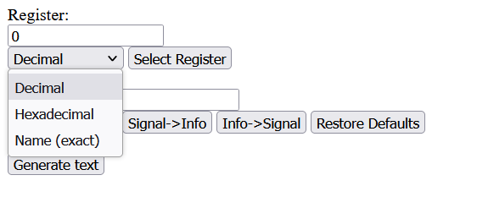
Registers
Figure 1: Register Selection

Slide 5
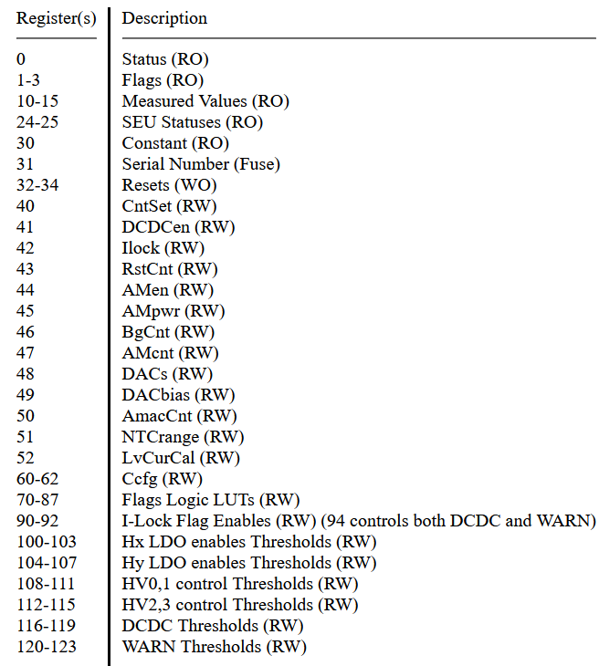
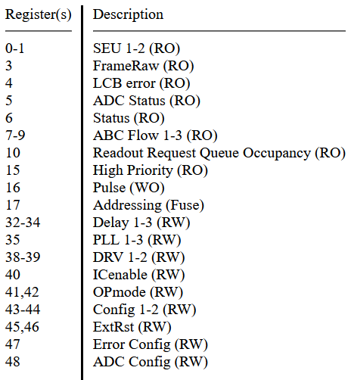
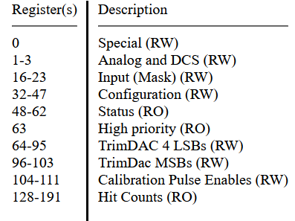
Registers cont.
Figure 2: ABCStar Register Descriptions
Figure 3: HCCStar Register Descriptions
Figure 4: AMACStar Register Descriptions

Slide 6
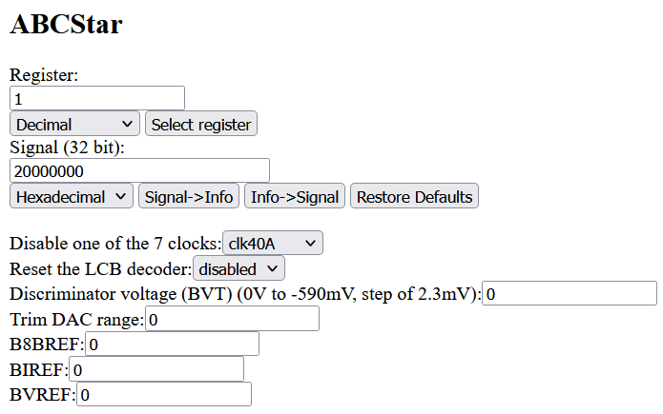
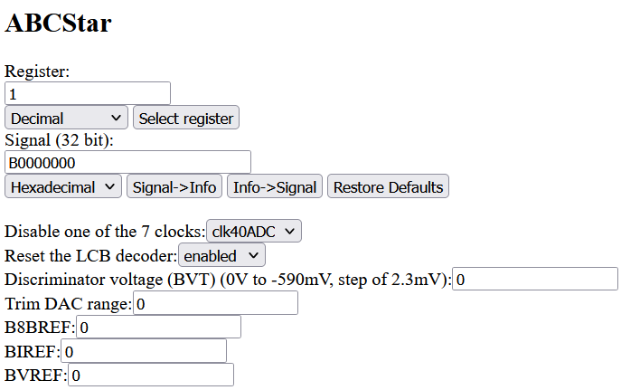
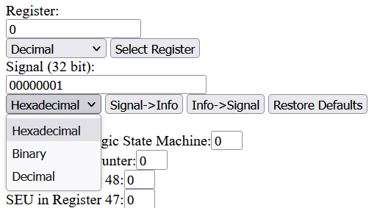
Conversion with Example 1
Figure 5: Signal to Info Conversion for ABCStar Register 1
Figure 6: Info to Signal Conversion for ABCStar Register 1
Figure 7: Signal Base Number Options
Notes:
-BIREF controls internal bias voltage
-clocks (in this case) is used to decode LCB signal
-LCB signal transfers triggers, fast commands, register read-writes and bunch counter reset (LOA/CMD/BCR) to HCCStar
-trim DAC: when we set the BVT voltage this sets the threshold for the entire chip. However, each individual strip or channel has ist own threshold voltage that can also be tuned. By adjusting the channel voltage we can normalize the response across the entire chip. So here the range can go from 0-31

Slide 7
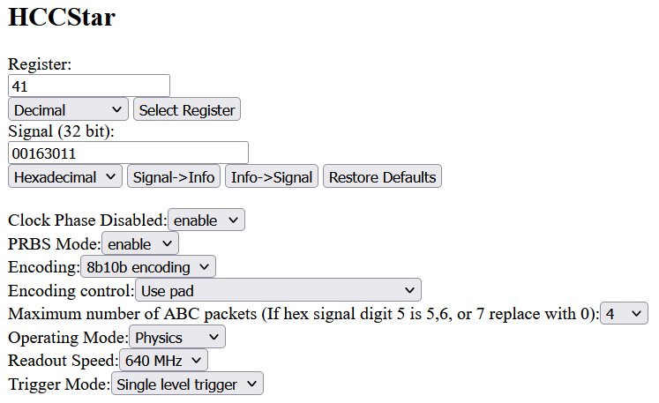
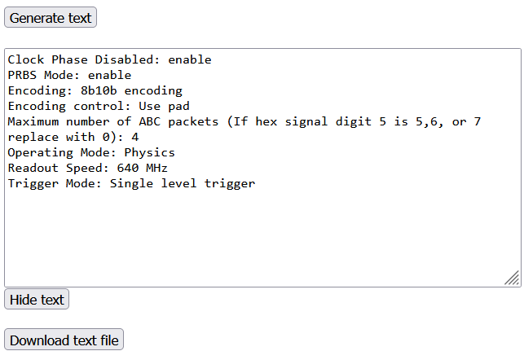
Conversion with Example 2
Figure 8: Info to Signal Conversion for HCCStar Register 41
Figure 9: Corresponding Text Output

Slide 8
References
https://gitlab.cern.ch/atlas-itkstrasic-group/abcstar/-/blob/master/abcstar/trunk/doc/ABCSTARV1_latex/ABCSTARV1_latex.pdf
https://gitlab.cern.ch/atlas-itkstrasic-group/hccstar/-/blob/hccstarv1-doc/doc/HCCStar_Spec.pdf
https://gitlab.cern.ch/atlas-itkstrasic-group/AMAC/-/blob/star_doc/doc/Specification/AMACStar_Spec.pdf

